Slide 1
Improving Coastal Marine Gravity: Towards 1mGal Accuracy Global Marine Gravity Anomaly from Satellite Altimetry
Edward D. Zaron (Portland State University)
David T. Sandwell (UCSD/Scripps Institution of Oceanography)
NGA-NARP Conference
September 10-12, 2013
Washington, DC

Slide 2
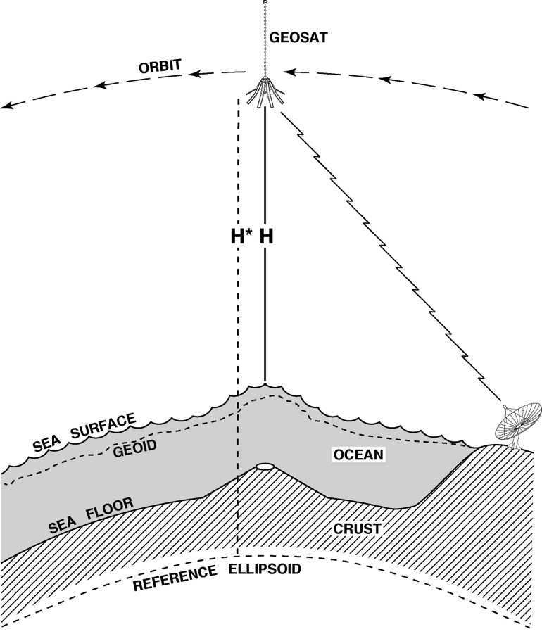
The Marine Geoid
Old Altimeters:
Geosat/GM
ERS-1/GM
New Altimeters
Envisat
CryoSat
Jason-1/GM
Use Laplace equation to convert time-average sea-surface slope to gravity anomaly.

Slide 3
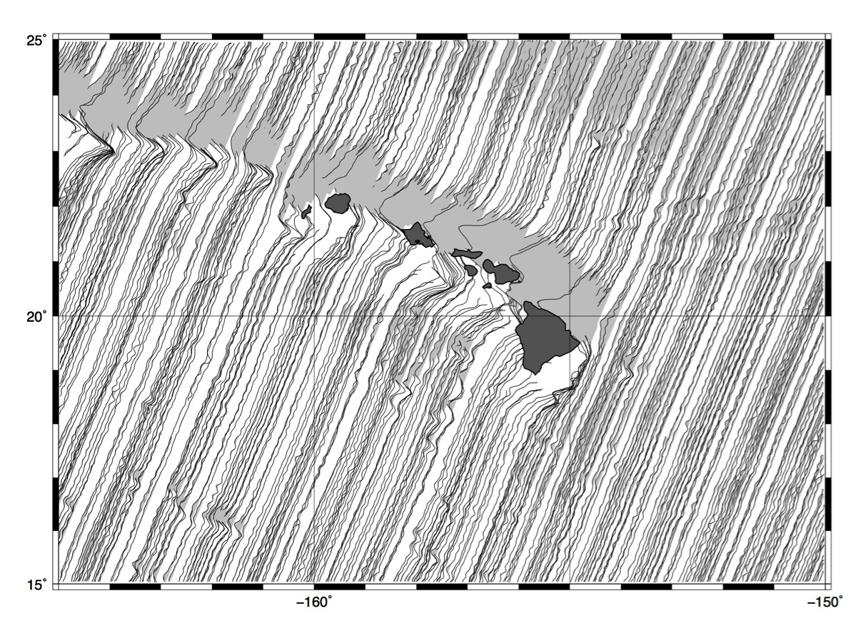
Geosat/GM (Old)

Slide 4
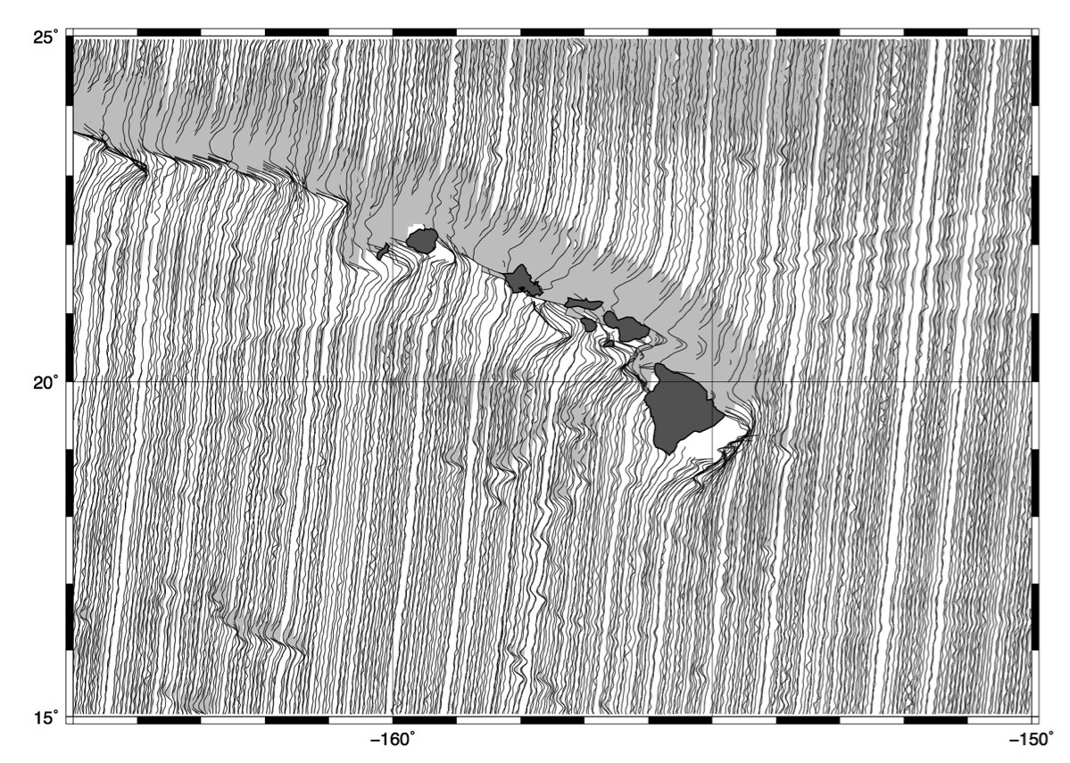
CryoSat (new – 24mo.)

Slide 5
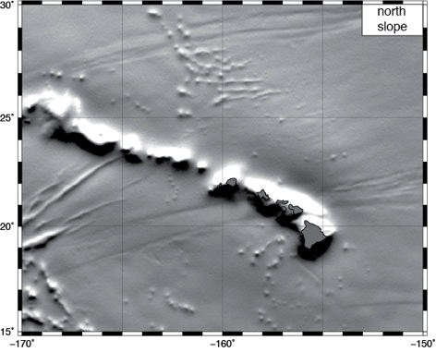
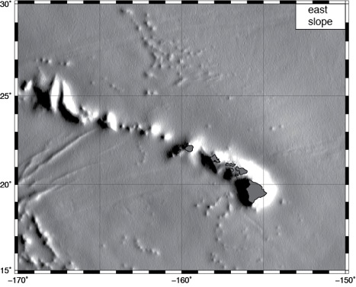
Gravity Anomaly from Slope
Applications:
Inertial navigation systems, sea-floor mapping and bathymetry, marine exploration, geology, etc.

Slide 6
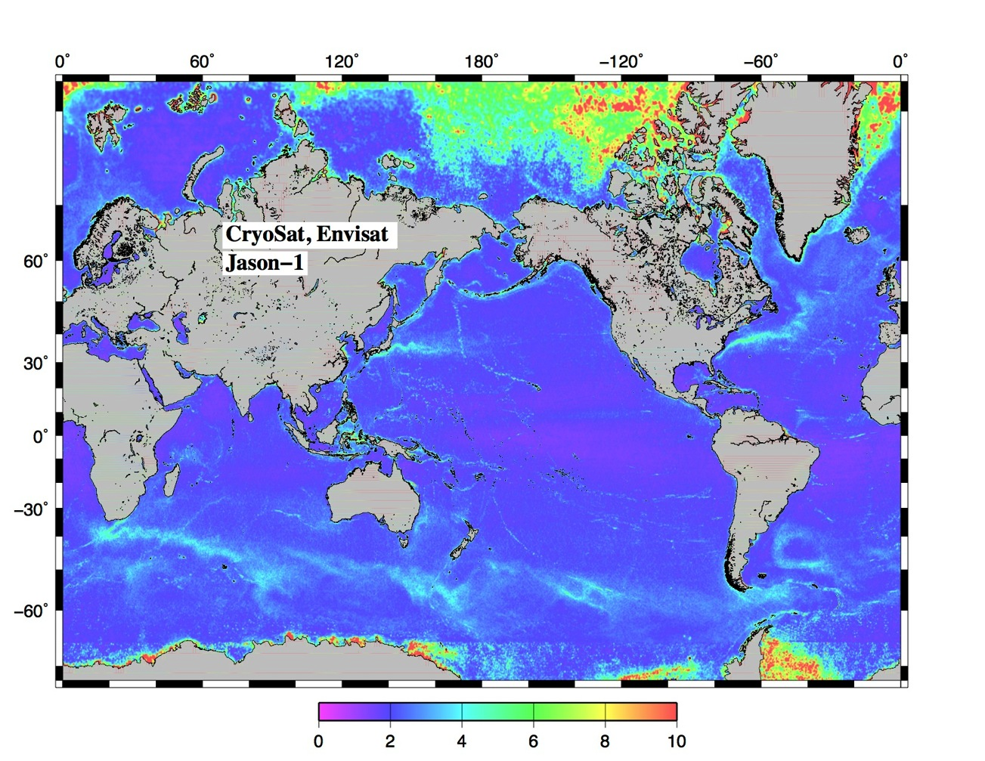
Errors in Global Marine Gravity
sea ice
edge effect
coastal tides
ocean variability
slope residual in microradians
0.98mGal = 1 microradian

Slide 7
Improving Coastal Marine Gravity: Towards 1mGal Accuracy Global Marine Gravity Anomaly from Satellite Altimetry
Goals:
Construct new global marine gravity anomaly from CryoSat-2, Jason-1, and Envisat – improve accuracy via waveform retracking
Develop new algorithms to ameliorate ocean/land edge effects.
Develop improved coastal tide models for correcting geodetic mission data.

Slide 8
Improving Coastal Marine Gravity
Present Efforts:
Upgrading V21.1 to V22.1 gravity model at http://topex.ucsd.edu
Evaluation of existing tide models
Software development for tidal analysis using non-repeat altimetry
Algorithm development to reduce edge-effects

Slide 9
Comparison of Tide Models

Slide 10
Tide Model Errors and Slope Residuals

Slide 11
Improving Coastal Marine Gravity
Transitions and Applications:
Bathymetry from marine gravity anomaly is currently used in Google Earth.
High-resolution gravity will be provided to NGA for evaluation in next-generation Earth gravity models.
New ocean tide models will have diverse applications in operational oceanography.

Slide 12
Improving Coastal Marine Gravity
Summary:
In combination with newly developed altimeter re-tracking algorithms, our research will permit more accurate and higher-resolution mapping of the marine gravity field.
Tide models developed will be useful to hydrographers and oceanographers working in the coastal ocean.
POC:
David T. Sandwell, dsandwell@ucsd.edu
Ed Zaron, zaron@cecs.pdx.edu
Nikolaos K. Pavlis, Nikolaos.K.Pavlis@nga.mil

